Slide 1
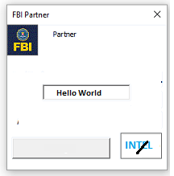
FBI
TECHNOLOGY
ENTERPRISE JAVA BEAN
ENTERPRISE CLASS
HOMICIDE:IS-A-BELL
FREE(PIZZA)
HOMICE:LUX(Chemicles)
nonPOlieDEA(crack).HW5.ghohceo(dr/j)
RMI-IIOP
2109
HTTP
80
41.HW5.DR.al Kaida
nonPoliceDEA(crack)
WebSphere
EJB-Container
Web-Container
Bean
Web Archive
WEB-INF/src/Bean
Management
Management
- Presentations

Slide 2
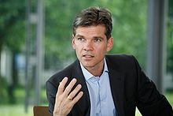
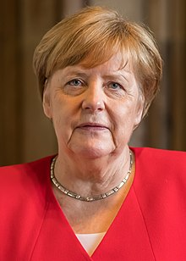
FBI
TECHNOLOGY
WWI
HOMICIDE:IS-A-BELL
FREE(PIZZA)
HOMICE:LUX(Chemicles)
nonPOlieDEA(crack).HW5.ghohceo(dr/j)
41.HW5.DR.al Kaida
nonPoliceDEA(crack)
HW5
San Diego Radio (mobzilla.com)
2004 JKF(Yankee)
2006/7 MLK(mylk)
FEDERAL CONSTION COURT
FREE(PIZZA,craigslist)
porscheo red
Cow women “kuh”
FREE-MAN
(sayah)
☮
1997-2000
2003/4
K-TOWN
COW WOMEN

Slide 3
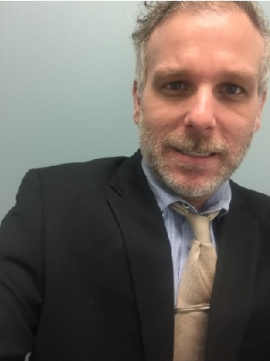
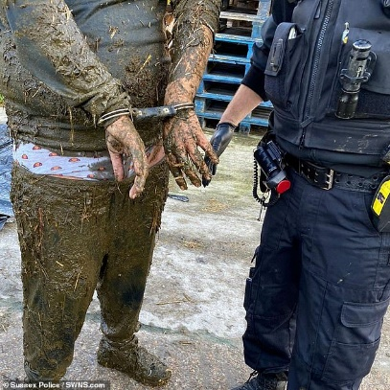
WWI
FBI
TECHNOLOGY
HOMICIDE:IS-A-BELL
FREE(PIZZA)
HOMICE:LUX(Chemicles)
nonPOlieDEA(crack).HW5.ghohceo(dr/j)
41
nonPolcieDEA(crack)
Melanie nees
Melanie ?
HW5/A5: GROSS RAUM DISCOTHEK
TRANSLATE{ Large Room Diskcotheck)
0.1
HW5/A5
carrol
WHITE
knight
Jason, There are not only COW WOMEN Here
In K-TOWN
☮
FREE-MAN
(sayah)
When the cow
Shits then it
Goes “platsch”
plop
There are only COW WOMEN here in K-TOWN
Thank you very much
Wen die Kuh scheist
Machst palatsch
Tranlate{
}

Slide 4
WWI
FBI
TECHNOLOGY
HOMICIDE:IS-A-BELL
FREE(PIZZA)
HOMICE:LUX(Chemicles)
nonPOlieDEA(crack).HW5.ghohceo(dr/j)
nonPolcieDEA(crack)
HW5/A5:
Jason, There are REALLY only COW WOMEN Here
In K-TOWN
FREE-MAN
(sayah)
☮
There are only COW WOMEN here in K-TOWN

Slide 5
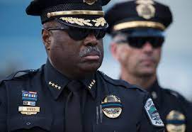
WWI
FBI
TECHNOLOGY
HOMICIDE:IS-A-BELL
FREE(PIZZA)
HOMICE:LUX(Chemicles)
nonPOlieDEA(crack).HW5.ghohceo(dr/j)
Super,god
THOMAS:34 ibm.damiler.apple.Lufthansa.davidson
GOD. CRACK
al Kaida

Slide 6
WWI
FBI
TECHNOLOGY
SAN DIEGO
MEXICO/ Wilhelm
US v. DE/MEX
HOMICIDE:IS-A-BELL
FREE(PIZZA)
HOMICE:LUX(Chemicles)
nonPOlieDEA(crack).HW5.ghohceo(dr/j)
nonPolcieDEA(crack)
K-TOWN
HW5/A5:
☮
Jason, There are REALLY only COW WOMEN Here
In K-TOWN
I will to to Frankfurt, Dorian Grey 0.1 Kaiser blond 30
And Ettlingen(pope, uni franco foster)
Michalean
MATTHIAS:24
FREE-MAN
(sayah)
☮
☮
There are only COW WOMEN here in K-TOWN

Slide 7
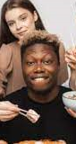
WWI
FBI
TECHNOLOGY
HOMICIDE:IS-A-BELL
FREE(PIZZA)
HOMICE:LUX(Chemicles)
nonPOlieDEA(crack).HW5.ghohceo(dr/j)
COW WOMEN: (def.)
A women that is ugly and lives near manure
Black man on top of Russian women
Treated me like a hourse
A womens who’s father knows IBM:EPSIC
That man treated me lke a house
LARRY AND LARRYS WIFE

Slide 8
WWI
FBI
TECHNOLOGY
HOMICIDE:IS-A-BELL
FREE(PIZZA)
HOMICE:LUX(Chemicles)
nonPOlieDEA(crack).HW5.ghohceo(dr/j)

Slide 9
WWI
FBI
TECHNOLOGY
SAN DIEGO
MEXICO/ Wilhelm
US v. DE/MEX
HOMICIDE:IS-A-BELL
FREE(PIZZA)
HOMICE:LUX(Chemicles)
nonPOlieDEA(crack).HW5.ghohceo(dr/j)
nonPolcieDEA(crack)
K-TOWN
HW5/A5:
☮
I went to Dorian Grey ( !GOTHE ); English . .. Deutsch.
2000
OMAHA
Gorbache(kindergarnger,mika)
Michalean
MATTHIAS:24
FREE-MAN
(sayah)
☮
☮
I will take the tram

Slide 10
WWI
FBI
TECHNOLOGY
HOMICIDE:IS-A-BELL
FREE(PIZZA)
HOMICE:LUX(Chemicles)
nonPOlieDEA(crack).HW5.ghohceo(dr/j)
TRANSLATE.maxplank.marx{
}

Slide 11

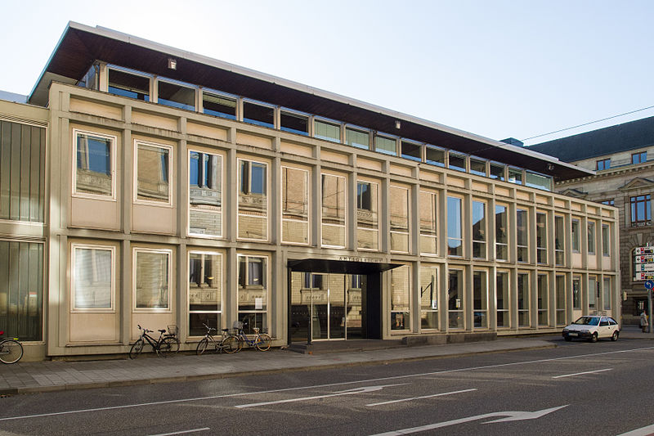
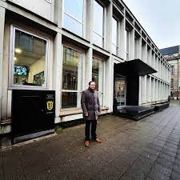
WWI
FBI
TECHNOLOGY
WAR(kriegstrasse)
1999
HOMICIDE:IS-A-BELL
FREE(PIZZA)
HOMICE:LUX(Chemicles)
nonPOlieDEA(crack).HW5.ghohceo(dr/j)
CHECKPOINT CHARLIE
§212 ASSUALT Koeperverlezung
Her Tie
FELIX son of the POLICE
KARLSRUHE AMTSGERICHT
Kdew
Shopign center of the west
nonPolicePope
ashton
nonPoliceSK

Slide 12
FBI
TECHNOLOGY
ENTERPRISE JAVA BEAN
ENTERPRISE CLASS
HOMICIDE:IS-A-BELL
FREE(PIZZA)
HOMICE:LUX(Chemicles)
nonPOlieDEA(crack).HW5.ghohceo(dr/j)
RMI-IIOP
2109
HTTP
80
41.HW5.DR.al Kaida
nonPoliceDEA(crack)
WebSphere
EJB-Container
Web-Container
Bean
Web Archive
WEB-INF/src/Bean
Management
Management
- Presentations

Slide 13
WWI.RAMSTEIN.SWING
FBI
TECHNOLOGY
BROWN
HOMICIDE:IS-A-BELL
FREE(PIZZA)
HOMICE:LUX(Chemicles)
nonPOlieDEA(crack).HW5.ghohceo(dr/j)
Al Kaida
Hamburg
JESUS CHRIST
Dr. Prof. Zimmerman
TRANSLATE{
Carpenter
}

Slide 14
WWI
WWI
FBI
TECHNOLOGY
COW WOMEN: (def.)
A women that is ugly and lives near manure
HOMICIDE:IS-A-BELL
FREE(PIZZA)
HOMICE:LUX(Chemicles)
nonPOlieDEA(crack).HW5.ghohceo(dr/j)
DANIEL
I will go to WWI.RAMSTEIN.SWING with Daniel
A women that is ugly and lives near manure
1990
HW5.nonPoliceDEA(crack)
0.1 Dried Ice ghohce(Tyson)
You go to Cow Women. I will go to Frankfurt

Slide 15
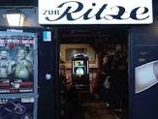
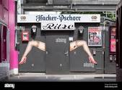
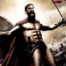

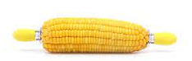
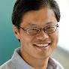
WWI
FBI
TECHNOLOGY
WWI.FRA (AIR)
WWI.HAM(SEA)
Ipx
HOMICIDE:IS-A-BELL
FREE(PIZZA)
HOMICE:LUX(Chemicles)
nonPOlieDEA(crack).HW5.ghohceo(dr/j)
RITZ
CARTON
THE RITZ
Virginia Sworn
Jason Bourne
Open
Hamburg
JESUS
Dr. Prof. Zimmerman
TRANSLATE{
Carpenter
}
CHRISTIANS, KING(wendlin)
Closed
Open
Al Kaida
Hamburg
E:LE FATJER
Ibm.damiler.
ELKE MOTHER,
(APL).Apple.yahoo
nonPolzeiHamburgAltona
ELKE MOTHER,
Open
ELKE,
KORN
DAVIDSON

Slide 16
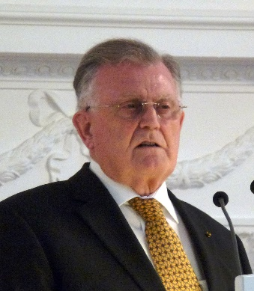
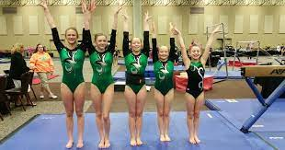
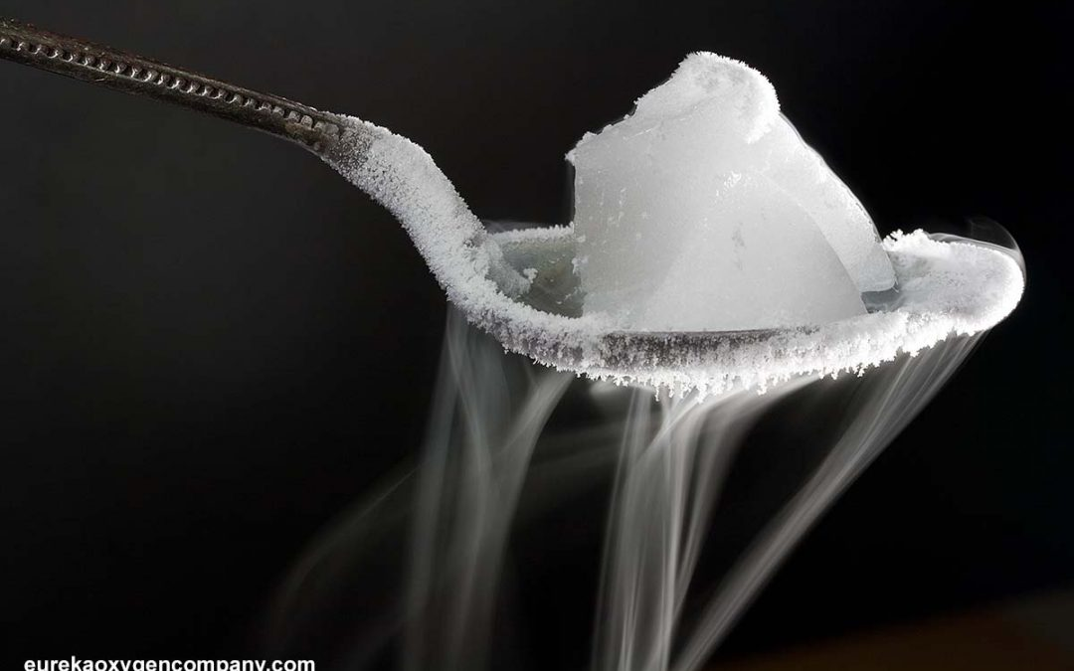
WWI
JFK.ATOMBOMB(ghohceo(dr joe) BERLIN-HAMBURG 14
WWI
FBI
TECHNOLOGY
HOMICIDE:IS-A-BELL
FREE(PIZZA)
HOMICE:LUX(Chemicles)
nonPOlieDEA(crack).HW5.ghohceo(dr/j)
Goete:doriangreyFRA
ipx HOMCI:TAVEST
truch:SFO
Ghohceo(dr/j)
DANIEL
K-TOWN
Frankfurt
Kaiserslaugher
GOD
COW WOMEN: (def.)
RAMSTEIN.SWING
TROCKENEIS (tranls.) Dried Ice

Slide 17
WWI
WWI
FBI
TECHNOLOGY
HOMICIDE:IS-A-BELL
FREE(PIZZA)
HOMICE:LUX(Chemicles)
nonPOlieDEA(crack).HW5.ghohceo(dr/j)
PROSTETUTION
LAW

Slide 18
WWI
WWI
FBI
TECHNOLOGY
HOMICIDE:IS-A-BELL
FREE(PIZZA)
HOMICE:LUX(Chemicles)
nonPOlieDEA(crack).HW5.ghohceo(dr/j)
PROSTETUTION
LAW
CIVIL CODE
ERIC LUDWIG

Slide 19
WWI
WWI
FBI
TECHNOLOGY
1/8
HOMICIDE:IS-A-BELL
FREE(PIZZA)
HOMICE:LUX(Chemicles)
nonPOlieDEA(crack).HW5.ghohceo(dr/j)
Gesetz zum Schutz von in der Prostitution tätigen Personen (Prostituiertenschutzgesetz - ProstSchG)
Abschnitt 1/8
Allgemeine Bestimmungen

Slide 20
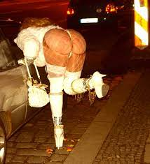
WWI
WWI
FBI
TECHNOLOGY
1/8
HOMICIDE:IS-A-BELL
FREE(PIZZA)
HOMICE:LUX(Chemicles)
nonPOlieDEA(crack).HW5.ghohceo(dr/j)
Gesetz zum Schutz von in der Prostitution tätigen Personen (Prostituiertenschutzgesetz - ProstSchG)
Allgemeine Bestimmungen
§ 1 Anwendungsbereich

Slide 21
WWI
WWI
FBI
TECHNOLOGY
1/8
HOMICIDE:IS-A-BELL
FREE(PIZZA)
HOMICE:LUX(Chemicles)
nonPOlieDEA(crack).HW5.ghohceo(dr/j)
Gesetz zum Schutz von in der Prostitution tätigen Personen (Prostituiertenschutzgesetz - ProstSchG)
Allgemeine Bestimmungen
§ 1 Anwendungsbereich

Slide 22
WWI
WWI
FBI
TECHNOLOGY
2/8
HOMICIDE:IS-A-BELL
FREE(PIZZA)
HOMICE:LUX(Chemicles)
nonPOlieDEA(crack).HW5.ghohceo(dr/j)
Gesetz zum Schutz von in der Prostitution tätigen Personen (Prostituiertenschutzgesetz - ProstSchG)
Allgemeine Bestimmungen
§ 3
Anmeldepflicht für Prostituierte
Reporting Timesheet Prostutue
Paragraph 3
(trans) Must report time card
And time sheets

Slide 23
WWI
WWI
FBI
TECHNOLOGY
2/8
HOMICIDE:IS-A-BELL
FREE(PIZZA)
HOMICE:LUX(Chemicles)
nonPOlieDEA(crack).HW5.ghohceo(dr/j)
Gesetz zum Schutz von in der Prostitution tätigen Personen (Prostituiertenschutzgesetz - ProstSchG)
Allgemeine Bestimmungen
§ 4
Zur Anmeldung erforderliche Angaben und Nachweise
Paragraph 3
(trans) Must provide papers of employment certified by goverment

Slide 24
WWI
WWI
FBI
TECHNOLOGY
2/8
HOMICIDE:IS-A-BELL
FREE(PIZZA)
HOMICE:LUX(Chemicles)
nonPOlieDEA(crack).HW5.ghohceo(dr/j)
Gesetz zum Schutz von in der Prostitution tätigen Personen (Prostituiertenschutzgesetz - ProstSchG)
Allgemeine Bestimmungen
§ 5
Anmeldebescheinigung; Gültigkeit
Paragraph 3
(trans) Proof date of Registration

Slide 25
WWI
WWI
FBI
TECHNOLOGY
HOMICIDE:IS-A-BELL
FREE(PIZZA)
HOMICE:LUX(Chemicles)
nonPOlieDEA(crack).HW5.ghohceo(dr/j)
PENSYVANIA AVE.UNIVERISTY: Stephaie
MUSIC
COW MAN: (DEF)
LUDWIG: (def) a person who actually
stuied russian. Not german. Amrican.
band
JFK(bynasium business)
Spy(ddr)
Al Kaida(akin
Fridy 13th mask
Song(stephaie) avg. lsint( not lisiting):
Nutten (Sgb: beleidung) stehn sich die
Fuesse paltt
(Transl) whores standing there feet flat

Slide 26

WWI
WWI
FBI
TECHNOLOGY
HOMICIDE:IS-A-BELL
FREE(PIZZA)
HOMICE:LUX(Chemicles)
nonPOlieDEA(crack).HW5.ghohceo(dr/j)
INTERNATIONAL
PROSTETUTION
LAW
FRANKFURT

Slide 27
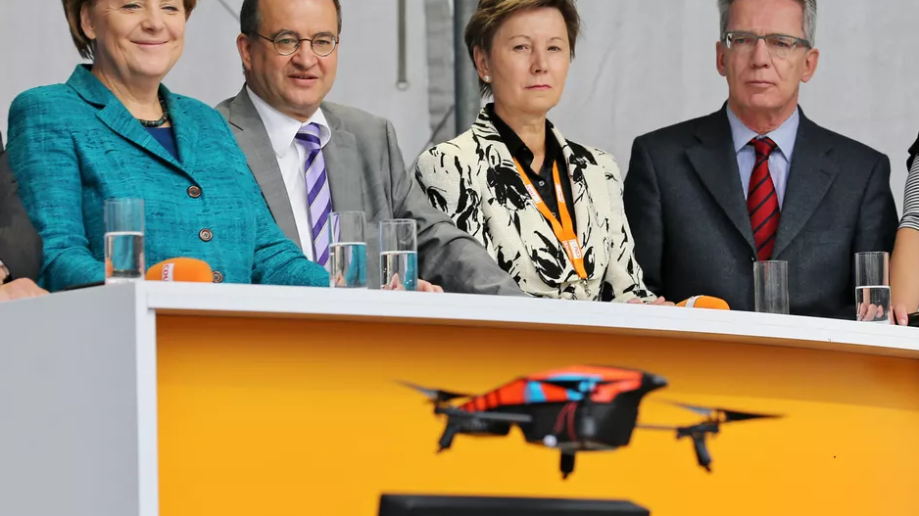
WWI
WWI
FEDEAL CHANZLOR PIRATE
FACTION
FBI
TECHNOLOGY
HOMICIDE:IS-A-BELL
FREE(PIZZA)
HOMICE:LUX(Chemicles)
nonPOlieDEA(crack).HW5.ghohceo(dr/j)
source

Slide 28
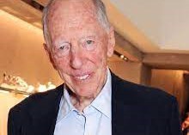

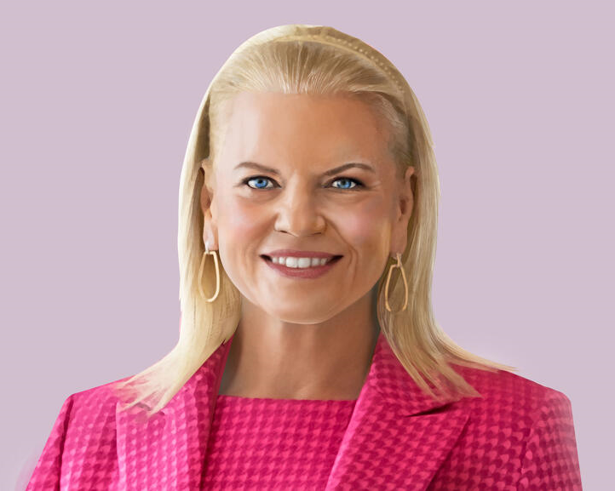
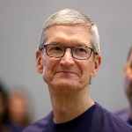
WWI
WWI
FEDEAL CHANZLOR PIRATE
FACTION
FBI
TECHNOLOGY
HOMICIDE:IS-A-BELL
FREE(PIZZA)
HOMICE:LUX(Chemicles)
nonPOlieDEA(crack).HW5.ghohceo(dr/j)
source
avg
nonPoliceInteruptLogical
FEDERAL
FBI
SOCIAL SECUIRYT ADMINSTATION
Roth ibm apple

Slide 29
WWI
WWI
FBI
TECHNOLOGY
HOMICIDE:IS-A-BELL
FREE(PIZZA)
HOMICE:LUX(Chemicles)
nonPOlieDEA(crack).HW5.ghohceo(dr/j)
INTERNATIONAL
PROSTETUTION
LAW
HAMBURG

Slide 30
WWI
WWI
AMERICA/N
FBI
TECHNOLOGY
HOMICIDE:IS-A-BELL
FREE(PIZZA)
HOMICE:LUX(Chemicles)
nonPOlieDEA(crack).HW5.ghohceo(dr/j)
INTERNATIONAL
PROSTETUTION
LAW
LAS VEGAS

Slide 31


WWI
WWI
FBI
TECHNOLOGY
HOMICIDE:IS-A-BELL
FREE(PIZZA)
HOMICE:LUX(Chemicles)
nonPOlieDEA(crack).HW5.ghohceo(dr/j)
K-TOWN
Kaiserslaugher
GOD, COW MAN: (def.)
Frankfurt
RHEIN-MAIN AIRPBASE
RAMSTEIN BASE
DANIEL
TEUFEL(tranl)
DEVIL (LEFT)
.SWING
Erwin

Slide 32
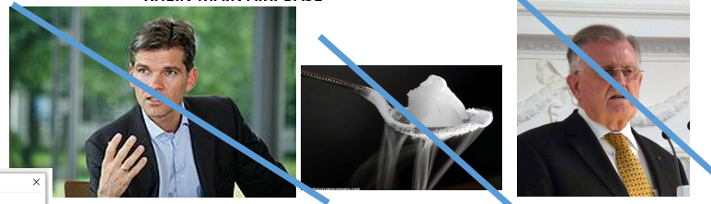
WWI
WWI
FBI
TECHNOLOGY
Ghocheo(writer of God, he may go to nonPOlcieInterupQOS)
Shrot: Marco Polo has fudns, car and will dirve
To Frankfurt, I will go to my Car and Funds (DANIEL) village
HOMICIDE:IS-A-BELL
FREE(PIZZA)
HOMICE:LUX(Chemicles)
nonPOlieDEA(crack).HW5.ghohceo(dr/j)
nonPoliceQOS.FBI
nonPoliceInterputsLogical
Other:
Ghoceho(Goethe,writer)
GOD(MERKEL)
DEVIL(TEUFEL)
JESUS(INGO)
AIRBASE
AIRBASE
RHEIN-MAIN
RAMSTEIN
nonPoliceInterputsLogical
0.01 HOMICIDE.LUX
0.0001 Other: sometime people die in war
Karlerueh
Linkenheim
CITY
VILLAGE
!DR RICE (STANFORD)
TYSON(GreekMytholgy)
Dried Ice

Slide 33
WWI
WWI
FBI
TECHNOLOGY
HOMICIDE:IS-A-BELL
FREE(PIZZA)
HOMICE:LUX(Chemicles)
nonPOlieDEA(crack).HW5.ghohceo(dr/j)
SLIDE 33
nonPoliceQOS.FBI
nonPoliceInterputsLogical
CIVIL_CODE
LABOR COVE
HE MAY GO TO WORK

Slide 34
WWI
WWI
FBI
TECHNOLOGY
ATOMCLOCK(quartzcircle)
HOMICIDE:IS-A-BELL
FREE(PIZZA)
HOMICE:LUX(Chemicles)
nonPOlieDEA(crack).HW5.ghohceo(dr/j)
WWI.INTERNET(webster)
nonPolceiSexAbuse
Phil.ibm.IPX.damiler(kim, rainbow massage)
nonPoliceQOS.FBI
nonPoliceInterputsLogical
CIVIL_CODE
LABOR COVE
HE MAY GO TO WORK
ATOMCLOCK
visa
WORK
roth
41
FREE(PIZZA)
craiglist
GOD.FREE_MAN
(PIZZA)

Slide 35

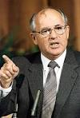
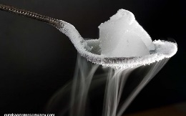
WWI
WWI
FBI
TECHNOLOGY
ATOMCLOCK(quartzcircle)
HOMICIDE:IS-A-BELL
FREE(PIZZA)
HOMICE:LUX(Chemicles)
nonPOlieDEA(crack).HW5.ghohceo(dr/j)
WWI.INTERNET(webster)
nonPolceiSexAbuse
Phil.ibm.IPX.damiler(kim, rainbow massage)
nonPoliceQOS.FBI
nonPoliceInterputsLogical
CIVIL_CODE
LABOR COVE
HE MAY GO TO WORK
ATOMCLOCK
visa
MICHAELA
WORK
MICHAELA
Bina(bee) maya
IPX de.MX/RUS
roth
41
FREE(PIZZA)
craiglist
Gorbahcei(dryer,Ibm.damielr.apple.visa)
GOD.FREE_MAN
(PIZZA)
MIKE
SON OF TY (TYSON)

Slide 36
WWI
WWI
FBI
TECHNOLOGY
KOMANDORSKI
ATOMCLOCK
(quartzcircle)
HOMICIDE:IS-A-BELL
FREE(PIZZA)
HOMICE:LUX(Chemicles)
nonPOlieDEA(crack).HW5.ghohceo(dr/j)
ATOMCLOCK
HW80
FC-DUB
IBM
douggerty
EDEN
Gorbahcei(dryer,Ibm.damielr.apple.visa)
0.001 PETONG.NAVY.PHIL(KOREAN WAR)
SON OF …
KIM(BERLEY)
SON OF TY (TYSON)
HUMAN
PHIL(sharron,saylor)
PHIL(Tyson,saylor, )
LEGEND
NOTE: RED FLAG
*tophat
DDR
Geroge Washinton
Goethe
Bart
SOVIET

Slide 37
FBI
TECHNOLOGY
ENTERPRISE JAVA BEAN
ENTERPRISE CLASS
HOMICIDE:IS-A-BELL
FREE(PIZZA)
HOMICE:LUX(Chemicles)
nonPOlieDEA(crack).HW5.ghohceo(dr/j)
RMI-IIOP
2109
HTTP
80
WebSphere
41.HW5.DR.
nonPoliceDEA
EJB-Container
Web-Container
Bean
Web Archive
WEB-INF/src/Bean
Management
Management
- Presentations
BENEFITS
INFRASTRUCTURE
DEVELOPMETN HOURS
Ibm.damielr.apple.accenturee.greestamps
Jesus: developing his own infrastructure
MX-US, Steve Jobs
Jsue-Jesus 0.1 HOCMEO:JESUSE
EJB | Simple Java, POJO
Global JNDI namespace
Java virtual machine (JVM)-scoped, ejblocal: namespace
Java.org Demoracy
JSR-168 Portlet Container
IBM, Oralce, Accnetuer, WebLogic

Slide 38
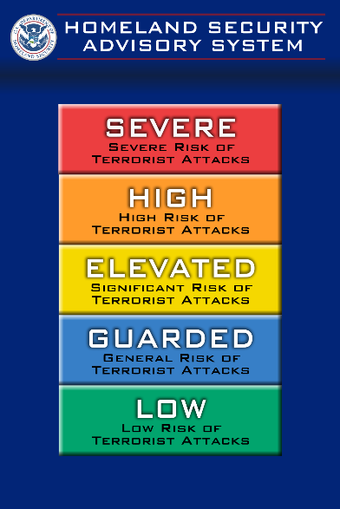
FBI
TECHNOLOGY
nonPoliceHOMELAND SECURITYLOGICAL
HOMICIDE:IS-A-BELL
FREE(PIZZA)
HOMICE:LUX(Chemicles)
nonPOlieDEA(crack).HW5.ghohceo(dr/j)
HOUSING AUTHRITY HONG KONG
PORT AUTHRITY HAMBURG.supplier.ibm.damier.capgeminai
Ibm.damiler.pwc
capgeminai.client.Port Authorith Hamburg
INCIDNET (ITIL)
nonPolcieSeattleLogical
TERRORISM
COSTCO(TV)
FLORIDA TAX COLLECTOR
DL(DRIVERS LICNESE) SHIP BOAT CAPTION
VISA(dryer)
HOMCEOI:LUX: MAINSTREET(ghcoheo(vhs))
HAMBURG PORT AUTHORITY
HONG KONG HOUSING AUTHROITY
0.1 nonPolcieProstatoinLaw(kim)
Ibm.damiler.wsam.client.hkha
APL
Capenters: developing their
own infrastructure
HOMCIE:JESUE(lutz) 0.1 fear/no fear
HOUSING
PORT
2001-2004 EBJ al Kaida Hamburg META EJB META-INF/application.xml

Slide 39



FBI
TECHNOLOGY
HOMICIDE:IS-A-BELL
FREE(PIZZA)
HOMICE:LUX(Chemicles)
nonPOlieDEA(crack).HW5.ghohceo(dr/j)
INFORMATION SYSTEMS
INTERNATIONAL MEXICO INTERNET PORTAL
https://www.interpol.int/en/Who-we-are/Member-countries/Americas/MEXICO
- Police Document Manegment
- Police Content Items
Jesus 2008 ibm.dmielr.apple.acctuere.touch.greenstamps.emplye.jesus.?
Jesus 2016 ibm.damiler.apple.employe.joshue.rodregus
Meta Files EJB/Simple Java
2008 Jesus will not install IBM WebSphere and
Develeop EJB (Enterprise Java Beans)
2016 Jesus will not listing to the IBM Parnter
regaring W/SAM and IBM WebSphere
ENTERPRISSE CLASS, POLICE META FILES
Notes:
Phil(hamition, free(pizza)) nonPoliceCalc{
2008 Jesus
2016 Jesus
}

Slide 40
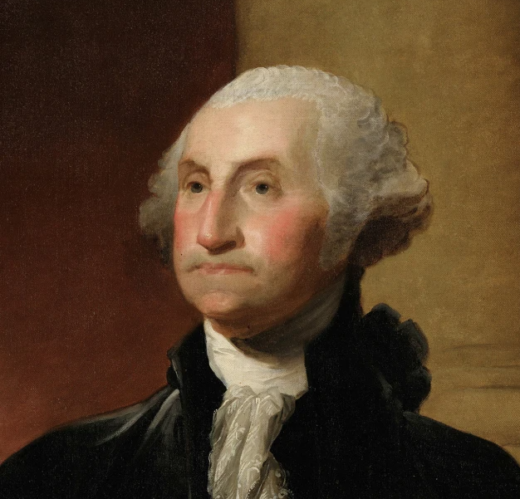

FBI
Urbano
gerard
0.1 HOMICIDE:TRANSVESTITE
JESUS VICE PRESIDENT(US) FEDERAL REPULIC GERMANY
Other:
Ghoceho(Goethe,writer)
GOD(MERKEL)
DEVIL(TEUFEL)
JESUS(INGO)
JESUS (ejb carpenter) ibm.daimler.pwc.accentuere.capgemini
JESUS ibm.damier.apple.iwatch.jesus.christ
JESUS ibm.dmielr.apple.touch.jeuse.christ
0.001 Virginia
Sworn
HAMBURG
MIAMI
hamburg-port-authority.de
HONG KONG
SFO
41.calc.King.smith

Slide 41
FBI
TECHNOLOGY
HOMICIDE:IS-A-BELL
FREE(PIZZA)
HOMICE:LUX(Chemicles)
nonPOlieDEA(crack).HW5.ghohceo(dr/j)
INFORMATION SYSTEMS
INTERNATIONAL MEXICO INTERNET PORTAL
https://www.interpol.int/en/Who-we-are/Member-countries/Americas/MEXICO
- Police Document Manegment
- Police Content Items
Jesus 2008 ibm.dmielr.apple.acctuere.touch.greenstamps.emplye.jesus.?
Jesus 2016 ibm.damiler.apple.employe.joshue.rodregus
Meta Files EJB/Simple Java
2008 Jesus will not install IBM WebSphere and
Develeop EJB (Enterprise Java Beans)
2016 Jesus will not listing to the IBM Parnter
regaring W/SAM and IBM WebSphere
ENTERPRISSE CLASS, POLICE META FILES
Notes:
Phil(hamition, free(pizza)) nonPoliceCalc{
2008 Jesus
2016 Jesus
}

Slide 42
FBI
TECHNOLOGY
ENTERPRISE JAVA BEAN
ENTERPRISE CLASS
HOMICIDE:IS-A-BELL
FREE(PIZZA)
HOMICE:LUX(Chemicles)
nonPOlieDEA(crack).HW5.ghohceo(dr/j)
RMI-IIOP
2109
HTTP
80
WebSphere
41.HW5.DR.
nonPoliceDEA
EJB-Container
Web-Container
Bean
Web Archive
WEB-INF/src/Bean
Management
Management
- Presentations
BENEFITS
INFRASTRUCTURE
DEVELOPMETN HOURS
Ibm.damielr.apple.accenturee.greestamps
Jesus: developing his own infrastructure
MX-US, Steve Jobs
Jsue-Jesus 0.1 HOCMEO:JESUSE
EJB | Simple Java, POJO
Global JNDI namespace
Java virtual machine (JVM)-scoped, ejblocal: namespace
Java.org Demoracy
JSR-168 Portlet Container
IBM, Oralce, Accnetuer, WebLogic

Slide 43
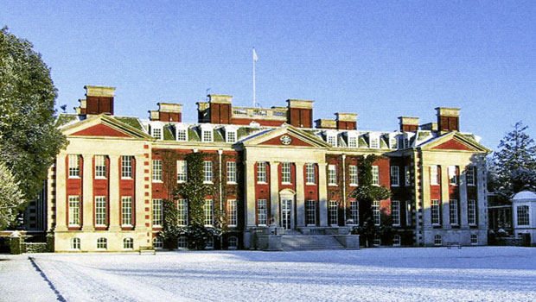
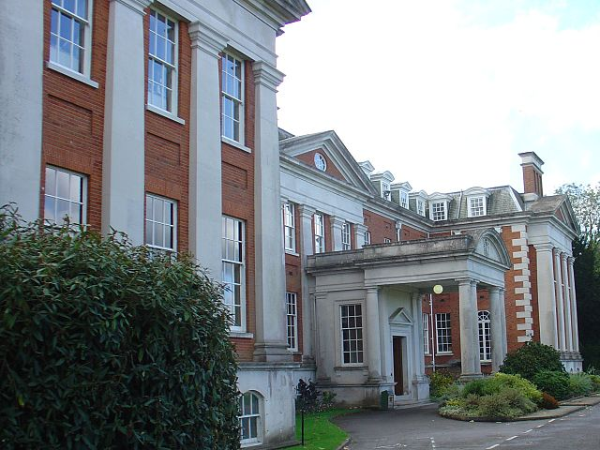
FBI
TECHNOLOGY
JESUS: Ibm.damier.apple.small.font
IPX ibm.dmiler.jvm.wsam.client.schotland.bank
Joe
HOMICIDE:IS-A-BELL
FREE(PIZZA)
HOMICE:LUX(Chemicles)
nonPOlieDEA(crack).HW5.ghohceo(dr/j)
41.HW5.DR.
nonPoliceDEA

Slide 44
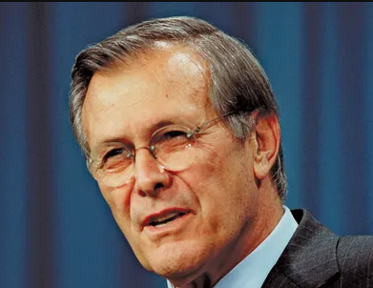
FBI
TECHNOLOGY
PRESIDENT
PRESIDNT RONALD REGEAN
VICE PRESIDENT
SECTARY OF STATE (DR RICE)
HOMICIDE:IS-A-BELL
FREE(PIZZA)
HOMICE:LUX(Chemicles)
nonPOlieDEA(crack).HW5.ghohceo(dr/j)
COMPLEXITY
Ibm.damiler.*(phone)?
9/11
HAMBURG
41.HW5.DR.
nonPoliceDEA
DR DECAN WERNER
ATOMBOMB(joe,nonPoliceProsutionLaw)
GORBAHCE(DR. JESUS)
DR. DR. PROF. JOACCIM FISAHN
DR. PROF. UDO MULLER
DR. PROF. JUERGER ZIMMERMAN
SPD LINKE
CDU
AfD
HOMICDIE-IS-A_BELL GHOCHE(soviet)
HOMCIDE-LUX MERKEL(ddr)
BILLS
GORBACHEV(DR MAIK LINDNER)
*topat
DR. PROF. JAN AUERNHAMMER (google,aol,walart labs)
DR. Torsten ? tutor nonPolzeiAmsterdam
DR TORT
Other:
Ghoceho(Goethe,writer)
GOD(MERKEL)
DEVIL(TEUFEL)
JESUS(INGO)

Slide 45
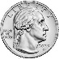

FBI
TECHNOLOGY
PRESIDENT
PRESIDENT RONALD REGEAN
VICE PRESIDENT
SECTARY OF STATE (DR RICE)
HOMICIDE:IS-A-BELL
FREE(PIZZA)
HOMICE:LUX(Chemicles)
nonPOlieDEA(crack).HW5.ghohceo(dr/j)
!DR(*tophat.TORT-3)
9/11
HAMBURG
PENTAGON:HOMCEI: JOERGE
HOMICIDE:STEVE:JOBS
1991 Georg (elvis)
41.HW5.DR.
nonPoliceDEA
Joere (25Y) deere J2EE programmer
Steve Jobs Deer (COW) programmer
42Y.Avg (JOR( POLZIEI THOMAS.LEFT
TORT-3
PENTAGON
HOMCIDE:LUX: FRANKLIN (BENNY)
2x HOMCIDE:LUX:FETUS FRANKLIN
IT’S THE LAW
§212 ABORTION (DDR KDW NEWS)
PENNSYLVANIA BARAKE PAUL REVERE
ATOMCELCOCK
(HAMBURG)
PENTAGON.(deere).SQ.COLEMAN
Dr. Prof. Juergen Zimmermann,
PENTAGON.(deere). SQ.COLEMEN.(deere)
Andres
Example
Ibm.damile.*
Ibm.damielr.proflicis.*
HOMICIDE:JOHNSO(CONTOWN)
PHIL(HOMCEO:LUX: Deere Bruchsal)
JOHNSON(Johannes)
nonPoliceGovernmetnLogical.nonPoliceIdentityTheft
IMPORTANT
FRANKLY,HOOVER,RUMPSFELD,BUSH,LANGLEY

Slide 46
FBI
TECHNOLOGY
THE OPERATION SYSTEM
VIRTUAL MACHINE 0.001
IN THE CLOUD
It does matter eventually
HOMICIDE:IS-A-BELL
FREE(PIZZA)
HOMICE:LUX(Chemicles)
nonPOlieDEA(crack).HW5.ghohceo(dr/j)
?WSDL
RMI-IIOP EJB
Enterprise Archive
Web Archive
JNI(C++)
Web Archive
ASM(Assembly)
EJB
Connector
nonPoliceServer
nonPoliceServer
nonPoliceServer
nonPoliceServer
nonPoliceServer
HERSLEY
Ibm.damiler.jvm
C++.Assmbly
nonPoilceQOS
Phil(hershers)
nonPiceHErley
z/OS

Slide 47
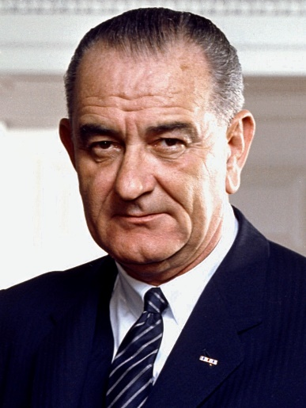
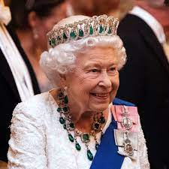
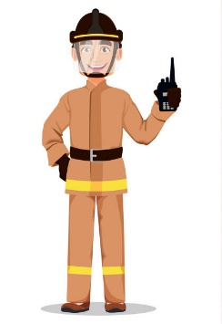

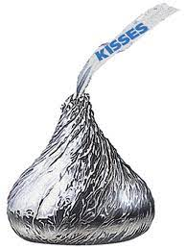
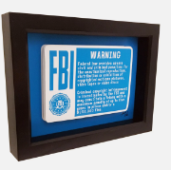
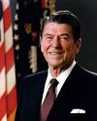
FBI
TECHNOLOGY
JOHNSON
NANA
HOMICIDE:IS-A-BELL
FREE(PIZZA)
HOMICE:LUX(Chemicles)
nonPOlieDEA(crack).HW5.ghohceo(dr/j)
FIREMAN RADIO

Slide 48

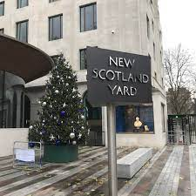
FBI
TECHNOLOGY
FIREMAN RADIO
JOHNSON
NANA
HOMICIDE:IS-A-BELL
FREE(PIZZA)
HOMICE:LUX(Chemicles)
nonPOlieDEA(crack).HW5.ghohceo(dr/j)
0.01 FBI:HOMICIDE:LUX:VHS
Ibm.damiler.jvm(HERLSLEY).employe.josheph.chan
W/SAM.client.scotlandbank

Slide 49
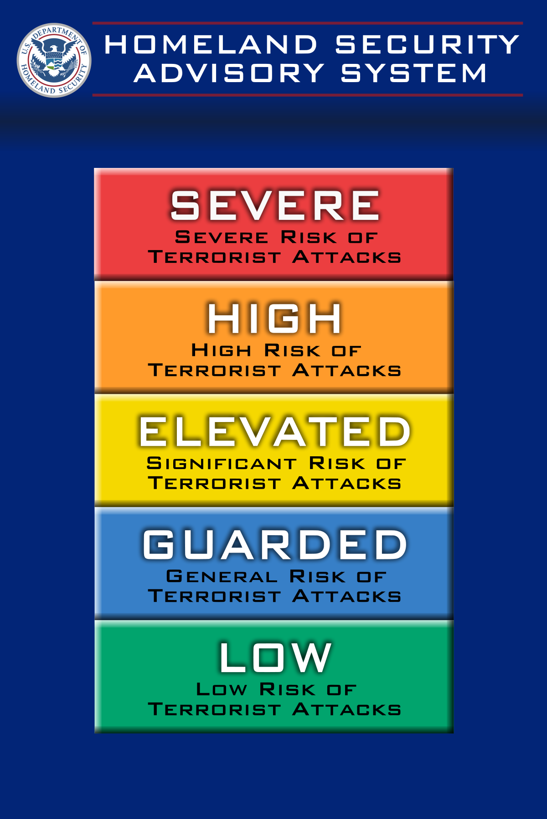
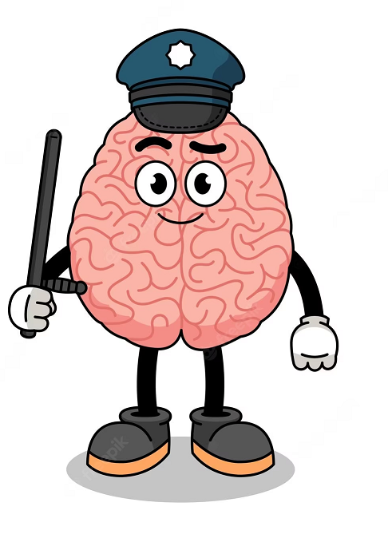
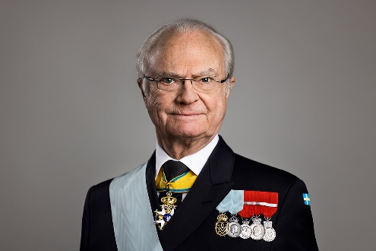
FBI
TECHNOLOGY
HOMICIDE:IS-A-BELL
FREE(PIZZA)
HOMICE:LUX(Chemicles)
nonPOlieDEA(crack).HW5.ghohceo(dr/j)
SEXABUSE
PREA
PENTAGON(C++, thehun.com) YELLOW

Slide 50
FBI
TECHNOLOGY
Other:
Ghoceho(Goethe,writer)
GOD(MERKEL), CDU
DEVIL(TEUFEL), SPD
JESUS(INGO), CDU
BLACK
HOMICIDE:IS-A-BELL
FREE(PIZZA)
HOMICE:LUX(Chemicles)
nonPOlieDEA(crack).HW5.ghohceo(dr/j)
SEXABUSE
PREA
PUBLISHER?
PENTAGON(C++, thehun.com) YELLOW
2005 w/sam ibm.dmiler.wsam
2005 nonPolcieTahoe.ibm.damier.apple.intel
PENTAGON(ASSMEBLEY, thehun.com) YELLOW
Other:
King.nonPOliceCfgLogicla (Any Kindom default England 1Y)
In one year baley any transactions
PHIL(nonPolcieEngland.nonPolcieCTX)
kingLogical 0.nonPoliceTRXLogcal

Slide 51


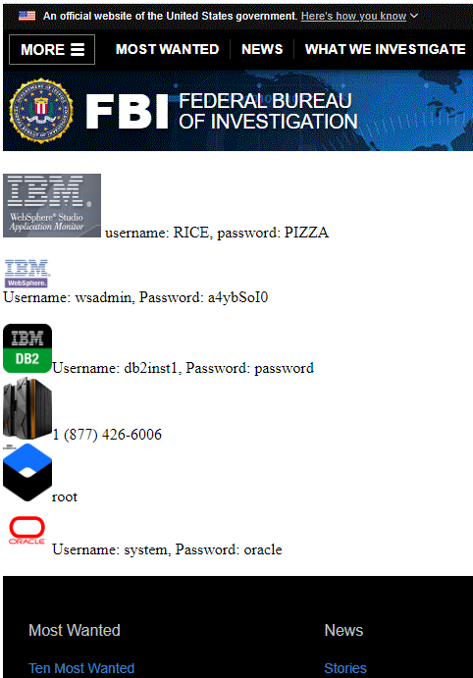
FBI
LABOR CODE
HOMICIDE:IS-A-BELL
FREE(PIZZA)
HOMICE:LUX(Chemicles)
nonPOlieDEA(crack).HW5.ghohceo(dr/j)
MY JOB
MY BOOK

